Slide 1
Philips HeartStart OnSite AED
June 2021

Slide 2
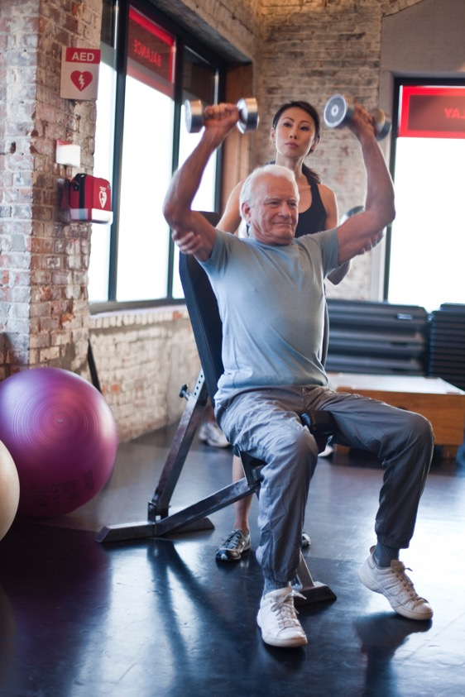
The landscape
Cardiovascular disease is a leading cause of global mortality, accounting for almost 17 million deaths annually, or 30% of all global mortality.¹
Most people have never been in a position to administer an AED. When the moment arrives, it is easy to panic. A calm voice walking you through the process step by step means
you are never alone. With Philips AED Solutions, you can
have an expert by your side.
It is crucial that AEDs be close at hand, ready to go, designed to be easy to use, lightweight and rugged.
1. Mehra R. Global public health problems of sudden cardiac death. Journal of Electrocardiology. 2007;40(6 Suppl);S118–122.
DOI: 10.1016/jelectrocard.2007.06.023.

Slide 3
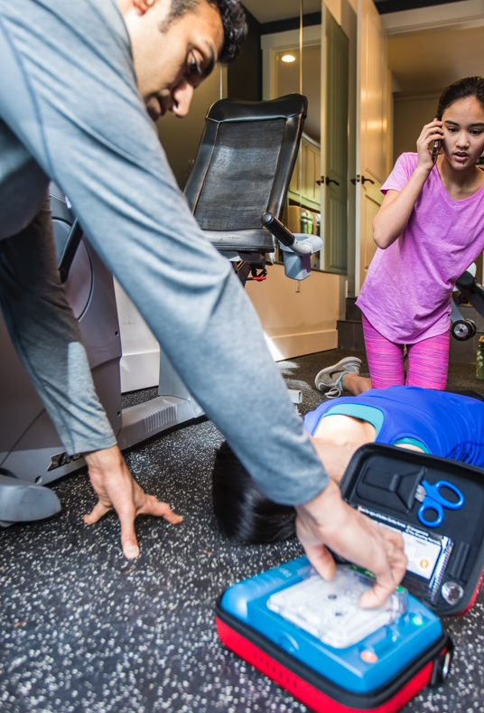
Every minute counts when it comes to saving lives
The survival rate from sudden cardiac arrest (SCA) is less than
1% worldwide and close to 5% in the United States.² More than
half the victims of the most common cause of SCA can survive
when treated with CPR and shock from a defibrillator within
three to five minutes of collapse.³
The Philips HeartStart OnSite AED guides you through a cardiac
emergency with a simple, step-by-step process, adaptive instructions and intelligent sensors to help deliver therapy.
Philips AED Solutions are designed for ease of use and reliability, with practical, real-time voice guidance – all brought to you by Philips, the trusted global leader in emergency care resuscitation.
2. Mehra R. Global public health problems of sudden cardiac death. Journal of Electrocardiology. 2007;40(6 Suppl):S118–122.
DOI: 10.1016/j.electrocard.2007.06.023.
3. Koster RW, Baubin MA, Bossaert LL, et al. European Resuscitation Council Guidelines for Resuscitation 2010: Section 2.
Adult basic life support and use of automated external defibrillators. Resuscitation. 2010;81(10):1277-1292.

Slide 4

Philips AED Solutions
partners with you
in the shared mission
of helping to save lives.
Side by side. Step by step.
Philips HeartStart OnSite AED

Slide 5
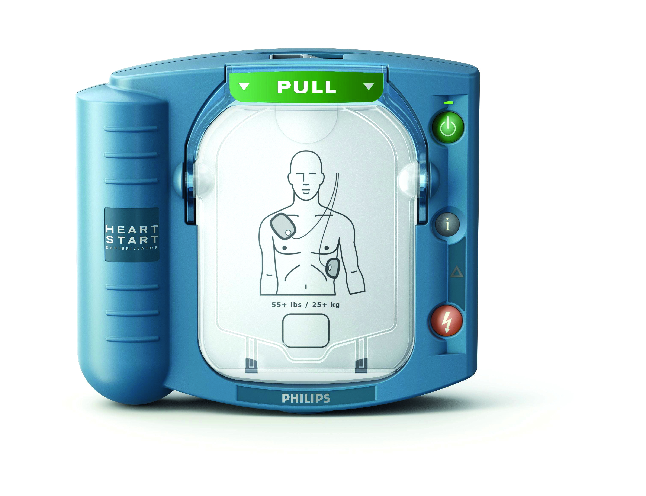
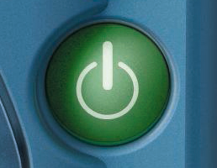
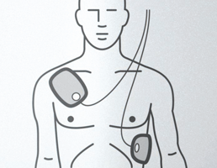
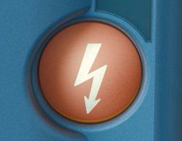
Easy as 1-2-3
1
Pull the handle on the Cartridge Cover and press the green On/Off button, which activates voice instruction and visual icons
2
Place the pads on the patient
as directed
3
When advised by the device,
press the orange Shock button
Patented Quick Shock feature allows OnSite
to typically deliver a shock within eight seconds after CPR.⁴
4. Nichol G, Sayre MR, Guerra F, Poole J. Defibrillation for Ventricular Fibrillation: A Shocking Update.
Journal of American College of Cardiology. 2017:70(12):1496–1509. DOI: 10.1016/j.jacc.2017.07.778.

Slide 6
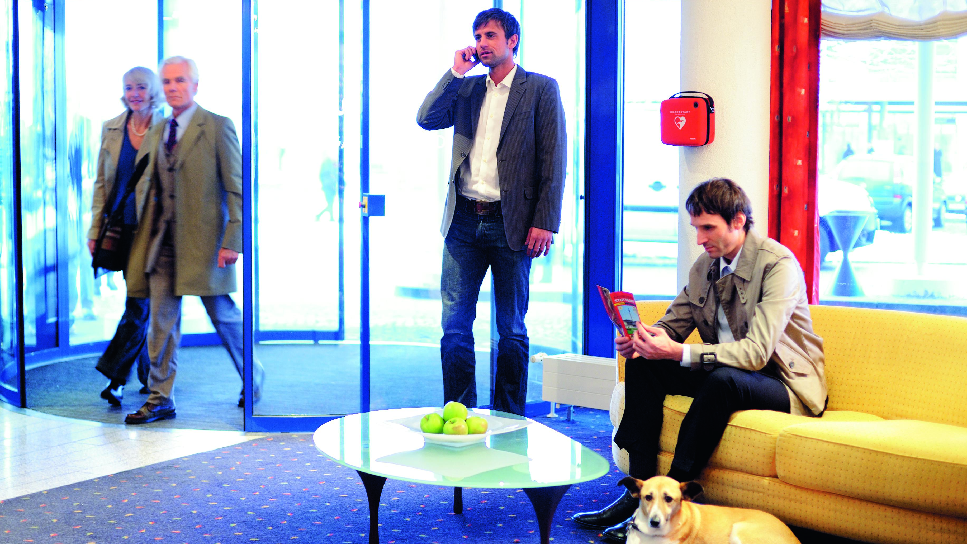

Ready to act. Ready to go.
Designed for the ordinary person in the extraordinary moment, OnSite is ready to act and virtually ready
to go. It allows anyone with little or no training to treat
the most common cause of SCA by delivering a shock quickly and effectively, wherever SCA happens.

Slide 7
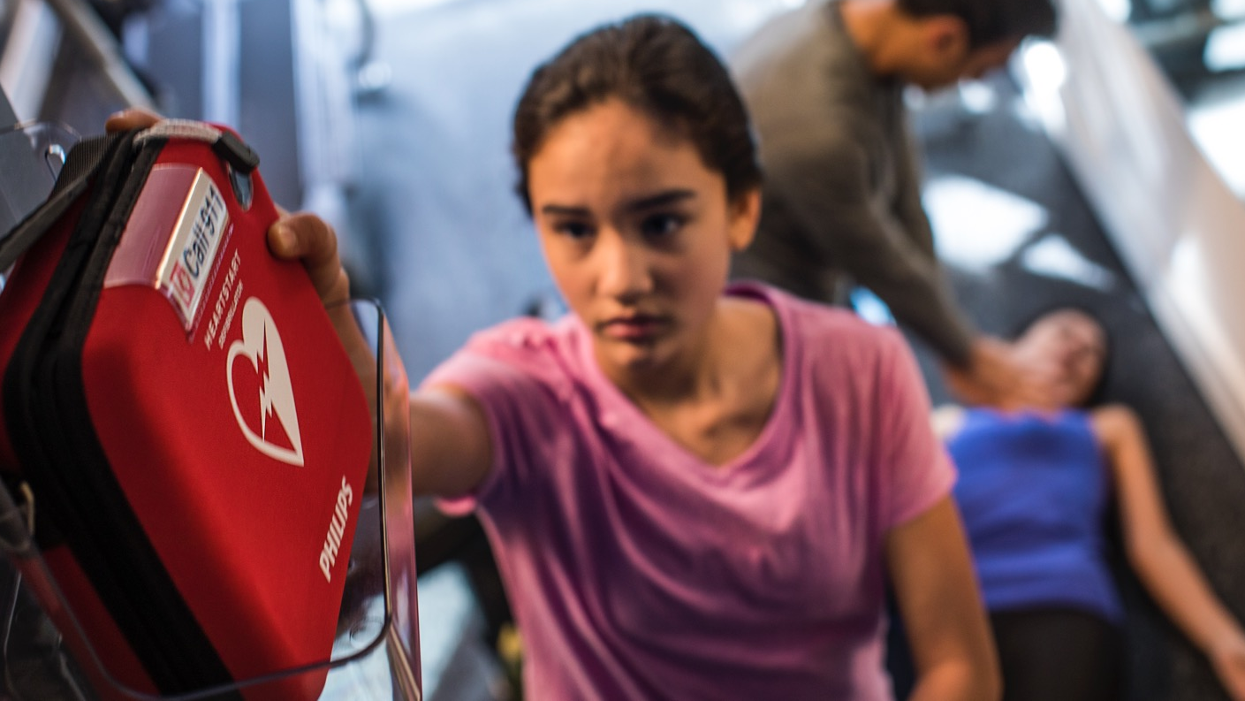
Start quickly. Treat confidently.
With access to the right equipment and support, you can help
save a life. OnSite guides you through the process of treating
a victim of suspected SCA. OnSite provides practical, real-time
guidance through step-by-step voice commands and CPR guidance.

Slide 8
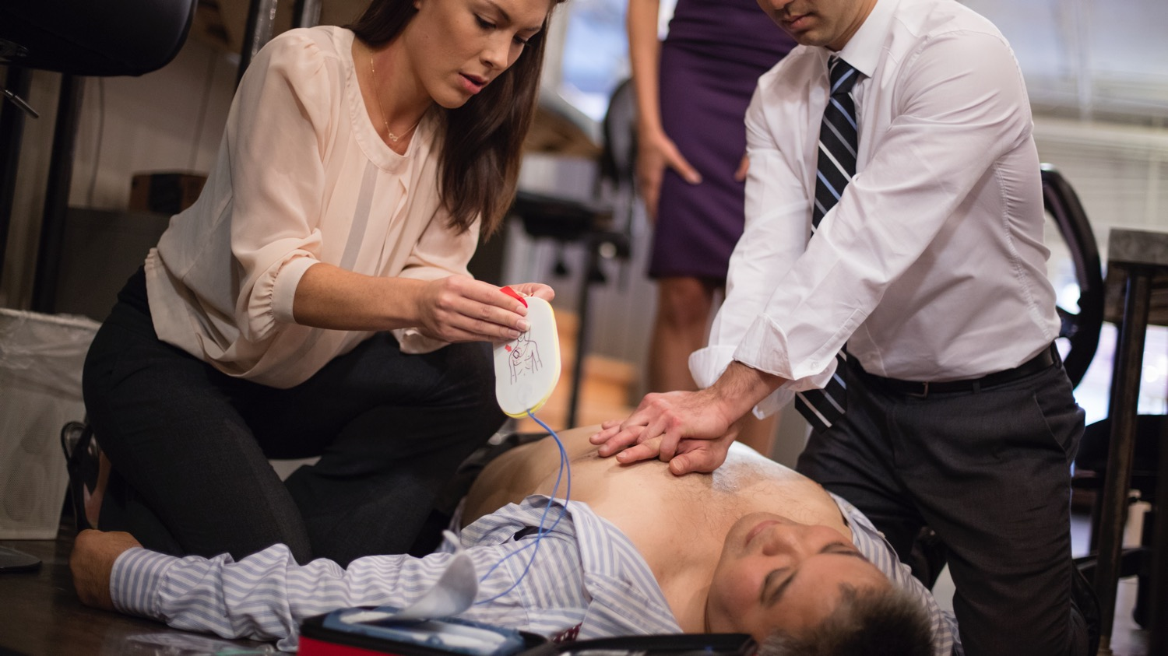
Adaptive voice instruction
We’ve equipped OnSite with integrated SMART Pads that will provide feedback
to the AED so it can adapt its voice instructions to your actions and your pace. The system won’t announce
the next step until you are ready. Prompts are repeated and rephrased
and include additional instruction
to aid understanding.

Slide 9
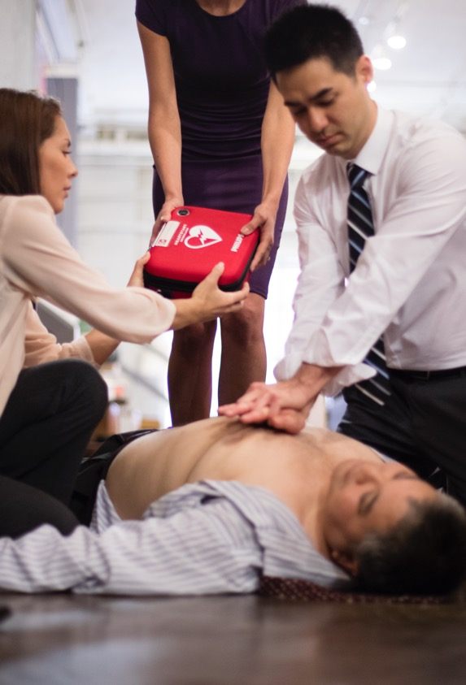
Expert guidance
OnSite assists you through the process of treating a victim of suspected SCA
and is the only AED available over the counter. OnSite provides practical,
real-time guidance through step-by-step voice commands and CPR guidance.
Includes features to help guide the treatment of SCA with easy setup, clear voice commands and real-time metronome
Arrives virtually ready to use. With the Ready-Pack configuration, OnSite is positioned inside the carry case, with Adult SMART Pads Cartridge and battery already installed and with a spare Adult SMART Pads Cartridge in place
Guides you through a cardiac emergency with a simple, step-by-step process,
adaptive instructions and intelligent sensors to help deliver therapy
Can be used on infants and children under 25 kg (55 lb) or 0-8 years old,
and adults and children over 25 kg (55 lb) or greater than 8 years old
Senses when the special Infant/Child SMART Pads Cartridge is installed,
and automatically adjusts CPR instructions and shock energy
Can be converted to a trainer with installation of training pads cartridge
Conducts a series of automatic self-tests daily, weekly and monthly, to check
pad readiness and verify functionality and calibration of circuits and systems

Slide 10
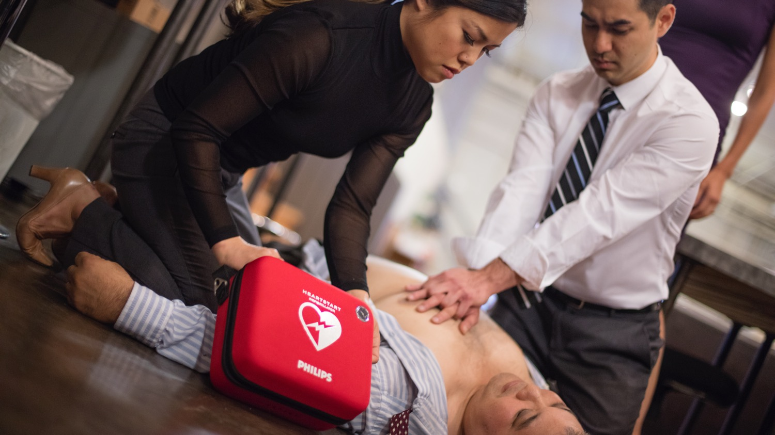
When every minute counts,
Philips AED Solutions are
a partner by your side.
With expert guidance and support,
Philips AED Solutions are here
when you need us most.
Side by side. Step by step.

Slide 11


4522 991 64061 * JUNE 2021

